Slide 1
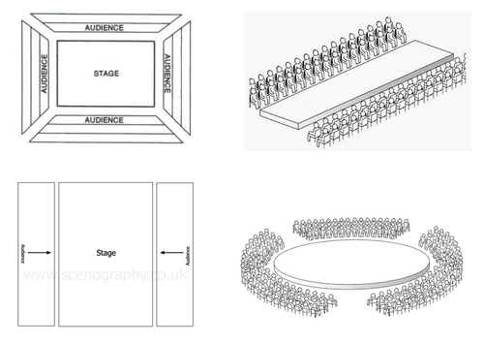
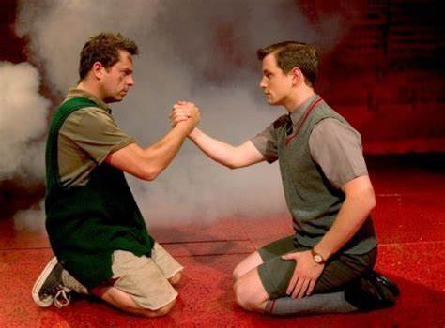
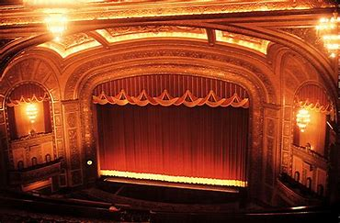
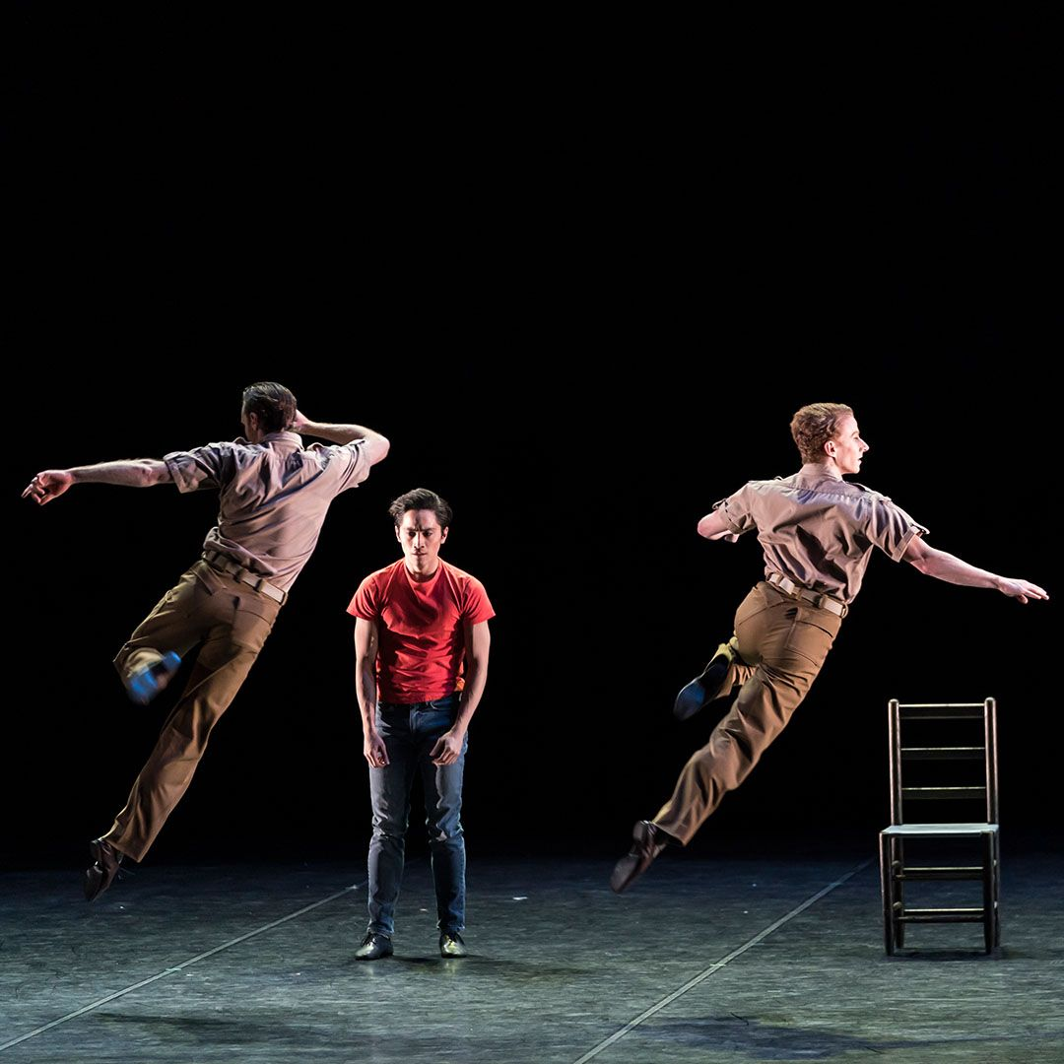
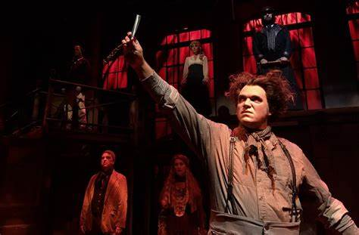
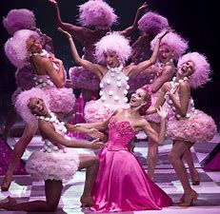
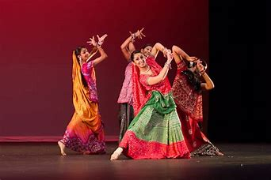
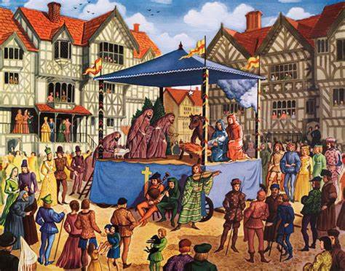
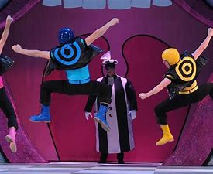
Penair School
Dance & Drama
A Levels?
BTECs?
Continue your lifelong love of learning and personal development
Post-16 Options
Describe
Explain
Analyse
Evaluate
A Level Drama
A Level Dance
BTEC Level 3 Performing Arts
BTEC Level 3 Musical Theatre BTEC Production Arts and Live Events
DRAMA EXAM- 40%
Section A: Drama and theatre terminology. Roles and responsibilities
Section B & C: Characteristics of performance.
Social, cultural and historical contexts.
How meaning is interpreted and communicated
Intention
Purpose
Interpretation
Strength
Stamina
Flexibility
EXAMS
Tone
Intonation
Mood
Silence
Stillness
Volume
Revise for and sit your theory paper (40%) to give yourself a competitive edge.
DANCE:
Component 3
External unit (40%)
DRAMA: Component 3 Texts in Practice. Study and interpretation of script. Performance of practical skills
DRAMA: Complete component 2 (40%)
FEBRUARY TRIAL EXAM
YEAR
DANCE: summer eomework- Exercise and techniques development.
Apply for post-16 option(s)
11
DANCE: Final completion of all theory work in controlled conditions. Practical performance.
DRAMA
Revision
Preparation for trial exam.
DANCE: Component 2- Developing skills and techniques in the performing arts (30%)
DRAMA
Section A
Roles and responsibilities. Theatre configuration & stage directions.
DANCE
Component 1 (30%)
Exploring the Performing Arts.
NOVEMBER TRIAL EXAM
Drama: Component 2- Devising drama
Practical exploration of style/genre.
To be able to use a variety of techniques. Recorded devising log.
DANCE
Study and analysis of professional work.
DANCE: Component 2 (30%)
Developing skills and techniques through the performing arts.
DRAMA
Practice devising
Ensemble skills.
Teamwork.
Development of vocal and physical skills.
Script
Study of text, application of vocal and physical skills. Blocking and proxemics.
DRAMA
Section B
Blood Brothers.
Duologues & Script Work
Development of memory and understanding of script &
character interpretation.
DRAMA & DANCE
Basic Theory
Practical performing skills.
Devising Drama
Work from a stimulus.
Development of skills, techniques and conventions.
Frantic Assembly
Movement techniques. Working from a stimulus.
Modern Theatre & Stage
Configuration, Stage-directions, Roles and responsibilities. Development of language.
Dance Workshops & Swansong
Skills development in a range of styles, intention and purpose. Appreciation of professional works. Working from a stimulus.
YEAR
10
YEAR
Options – BTEC TECH AWARD DANCE. AQA DRAMA
9
Spy Dance
Development of language and movement techniques. How to show character through movement.
Devising Drama- TIE
Development of
performing skills and ensemble skills, Introduction to Brechtian techniques.
Nightmares
Contemporary Dance.
Development of
techniques.
Analysing of professional works.
Victorian Melodrama.
Gothic Melodrama & Stage Fighting. Knowledge and understanding of styles
and genres. Devising and script work.
YEAR
Medieval Theatre
Miracle Plays. History of theatre. Working from a script. Develop vocal and physical skills. Awareness of audience.
Devising Drama- Bullying
Ensemble skills and movement skills. Working from a stimulus.
Dance Workshops
Introduction to skills and techniques
Drama Skills & Techniques
Teamwork and collaboration. Establishing routine and expectations.
8
YEAR
7
The Nutcracker by Matthew Bourne Appreciation of professional work. Development of skills.
Indian Dance Introduction to Action, Space, Dynamics. Dance skills and techniques.
Mime & Narration
Projection, confidence, clarity of movement & facial expression.
TEAMWORK | CREATIVITY | CONFIDENCE

